Slide 1

Credit EDA Case Study
Amrita Chatterjee and Padma A

Slide 2
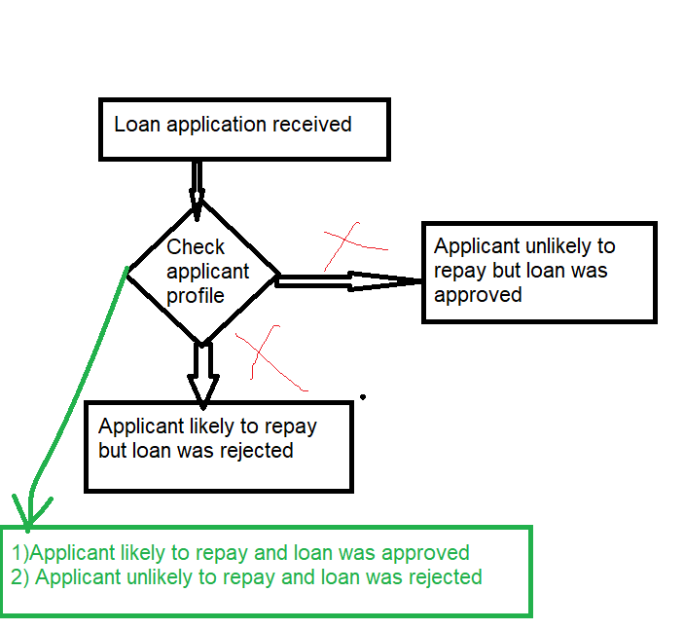
Business Understanding - Risks
Analyse the patterns present in the data.
Ensure that the applicants are capable of repaying the loan are not rejected.
Use PowerBI later

Slide 3
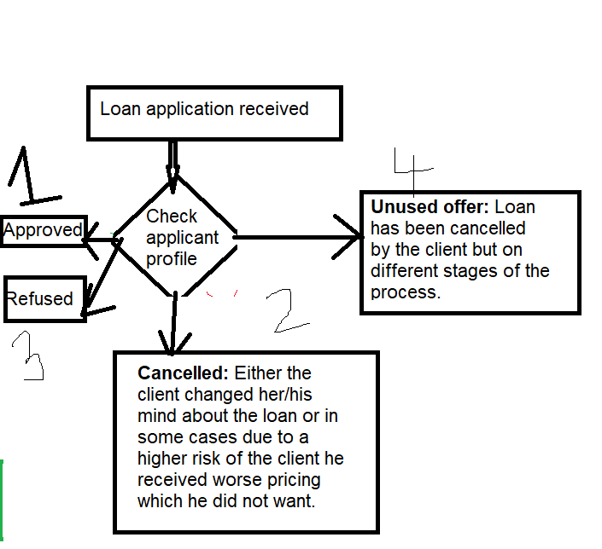
Business Understanding - Decisions

Slide 4
Business Objectives
This case study aims to identify patterns which indicate if a client has difficulty paying their installments.
These patterns may be used for taking actions such as
denying the loan
reducing the amount of loan
lending (to risky applicants) at a higher interest rate, etc.
This will ensure that the consumers capable of repaying the loan are not rejected.
Identification of such applicants using EDA is the aim of this case study.
Company wants to understand the driving factors (or driver variables) behind loan default, i.e. the variables which are strong indicators of default.

Slide 5
Data Understanding
1. 'application_data.csv' contains all the information of the client at the time of application. The data is about whether a client has payment difficulties.
2. 'previous_application.csv' contains information about the client’s previous loan data. It contains the data whether the previous application had been Approved, Cancelled, Refused or Unused offer.
3. 'columns_description.csv' is data dictionary which describes the meaning of the variables.

Slide 6
Data Understanding
https://drive.google.com/drive/folders/1PZxGcQVdEZHlaxwXo88WiJYy6_0SoJRQ

Slide 7
Data Cleaning

Slide 8
Data Manipulation

Slide 9
Handling Missing Values

Slide 10
Handling Outliers

Slide 11
Data Imbalance

Slide 12
Data Analysis

Slide 13
Univariate/Bivariate Analysis

Slide 14
Correlation for payment difficulties

Slide 15
Recommendations

